Slide 1

Advanced Programming CMP 102
Dr. Perihan PEHLİVANOĞLU
Biruni Univarsity
Department of Computer Engineering 2023
Spring

Slide 2
Course Plan
Introduction - Functions (Recursive functions) Arrays, ArrayList, Vector
Collections (List, Queue, Stack, Set, Map, Tree)
Streams, Files
Generics and Exceptions
Midterm Exam

Slide 3
Course Plan
Visual Programming Fundamentals Designing a Form Controls and Forms Properties of Components and Events Final Exam

Slide 4

Last Lecture
JavaFX examples.

Slide 5
Motivation
In this lecture, we will focus on Example programs in visual programming in Java. We will learn Menu design.

Slide 6
JavaFX Program Structure

Slide 7
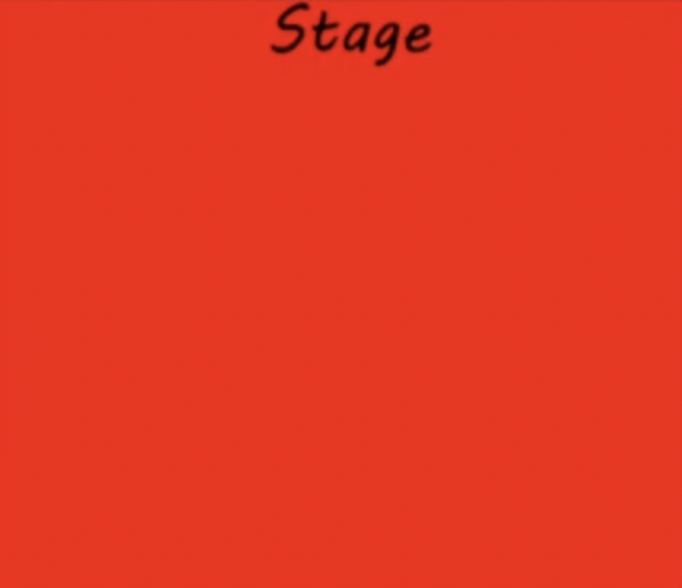
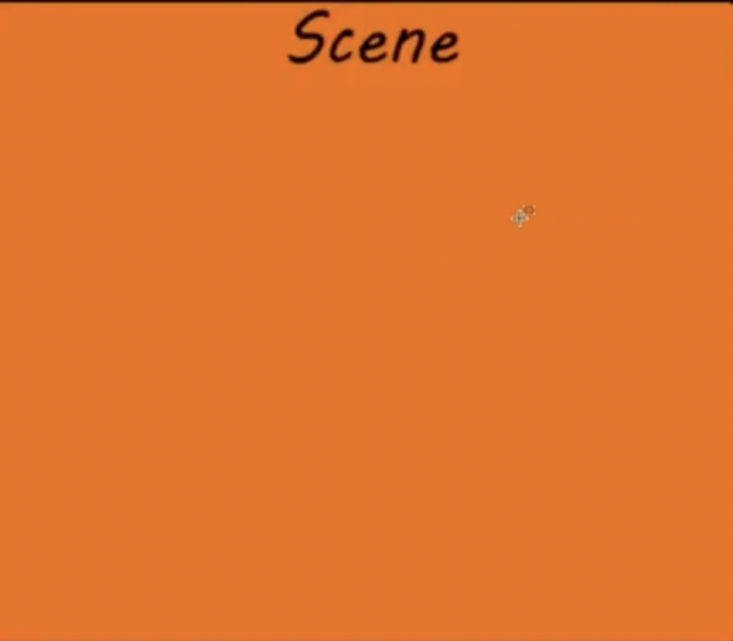
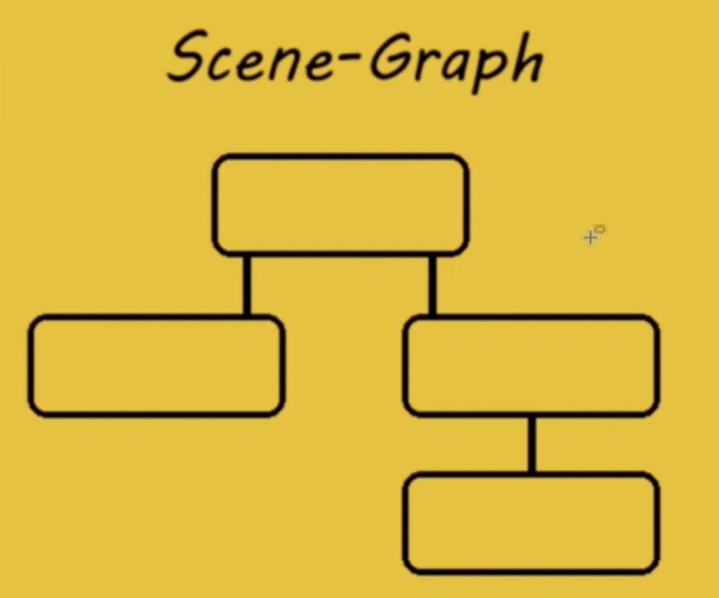
JavaFX Program
Consists of Stage, Scene and nodes.

Slide 8
The Basic Structure of a JavaFX Program
JavaFX is a modern graphical user interface (GUI) framework for creating desktop and mobile applications. The program structure of a JavaFX application consists of the following components:
Application class: This is the entry point of the JavaFX application, which extends the javafx.application.Application class. It contains the main() method, which launches the application.
Stage class: A stage represents a top-level container or window of a JavaFX application. The stage is created in the start() method of the Application class.
Scene class: A scene represents the content of a stage, which is defined using the javafx.scene.Scene class. A scene can contain one or more nodes, such as buttons, text fields, labels, and images.
Layouts: JavaFX provides various layout classes to arrange nodes in the scene, such as VBox, HBox, BorderPane, GridPane, and FlowPane. These layouts help to organize the user interface elements in a structured manner.
Nodes: Nodes are the graphical components that are placed inside the scene, such as buttons, text fields, labels, and images. Each node is an instance of a class that extends the javafx.scene.Node class.
Event handling: JavaFX provides a comprehensive event handling mechanism to handle user interactions, such as button clicks, mouse movements, and key presses. Event handling is done using the EventHandler interface and the setOn<ActionEvent>() method.
CSS styling: JavaFX supports CSS styling for styling the user interface elements. You can use CSS to define the color, font, size, and layout of the nodes in the scene.
In summary, the program structure of a JavaFX application consists of the Application class, Stage class, Scene class, Layouts, Nodes, Event handling, and CSS styling.

Slide 9
Java FX UI Controls
You can add controls to a form that you create with Java FX User Interface Controls.
Label
Button
Radio Button
Toggle Button
Checkbox
Choice Box
Text Field
Password Field
Scroll Bar
Scroll Pane
List View
Table View
Tree View
Tree Table View
Combo Box
Separator
Slider
Progress Bar and Progress Indicator
Hyperlink
Tooltip
HTML Editor
Titled Pane and Accordion
Menu
Color Picker
Date Picker
Pagination Control
File Chooser
Customization of UI Controls
UI Controls on the Embedded Platforms

Slide 10
Menu
You can create menus in JavaFX.
Menus make selection easier and are widely used in window applications.
JavaFX provides five classes that implement menus:
MenuBar,
Menu,
MenuItem,
CheckMenuItem, and
RadioButtonMenuItem.

Slide 11
Menu
MenuBar is a top-level menu component used to hold the menus.
A menu consists of menu items that the user can select (or toggle on or off).
A menu item can be an instance of MenuItem, CheckMenuItem, or RadioButtonMenuItem.
Menu items can be associated with nodes and keyboard accelerators.

Slide 12
Menu
By adding a menu in visual programming, you can enable the user to choose the functions of the program you will write.

Slide 13
Creating Menus
The sequence of implementing menus in JavaFX is as follows:
1. Create a menu bar and add it to a pane. For example, the following code creates a pane and a menu bar, and adds the menu bar to the pane:
MenuBar menuBar = new MenuBar(); Pane pane = new Pane(); pane.getChildren().add(menuBar);
2. Create menus and add them under the menu bar. For example, the following creates two menus and adds them to a menu bar, as shown in Figure 31.20a:
Menu menuFile = new Menu("File");
Menu menuHelp = new Menu("Help"); menuBar.getMenus().addAll(menuFile, menuHelp);

Slide 14
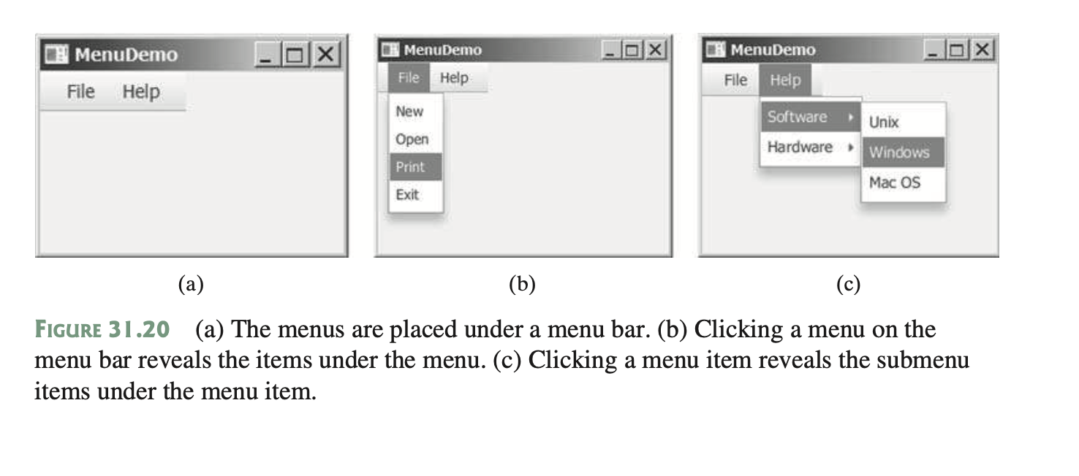
Creating Menus

Slide 15
Creating Menus
3. Create menu items and add them to the menus.
menuFile.getItems().addAll(new MenuItem("New"), new MenuItem("Open"), new MenuItem("Print"), new MenuItem("Exit"));
This code adds the menu items New, Open, Print, and Exit, in this order, to the File menu, as shown in Figure 31.20b.
3.1. Creating submenu items.
You can also embed menus inside menus so the embedded menus become submenus. Here is an example:
Menu softwareHelpSubMenu = new Menu("Software");
Menu hardwareHelpSubMenu = new Menu("Hardware"); menuHelp.getItems().add(softwareHelpSubMenu); menuHelp.getItems().add(hardwareHelpSubMenu); softwareHelpSubMenu.getItems().add(new MenuItem("Unix")); softwareHelpSubMenu.getItems().add(new MenuItem("Windows")); softwareHelpSubMenu.getItems().add(new MenuItem("Mac OS"));
This code adds two submenus, softwareHelpSubMenu and hardwareHelpSubMenu, in MenuHelp. The menu items Unix, NT, and Win95 are added to softwareHelpSub- Menu (see Figure 31.20c).

Slide 16
Creating Menus
3.2. Creating check-box menu items.
You can also add a CheckMenuItem to a Menu. CheckMenuItem is a subclass of Menu- Item that adds a Boolean state to the MenuItem and displays a check when its state is true. You can click a menu item to turn it on or off. For example, the following statement adds the check-box menu item Check it (see Figure 31.21a).
menuHelp.getItems().add(new CheckMenuItem("Check it"));

Slide 17
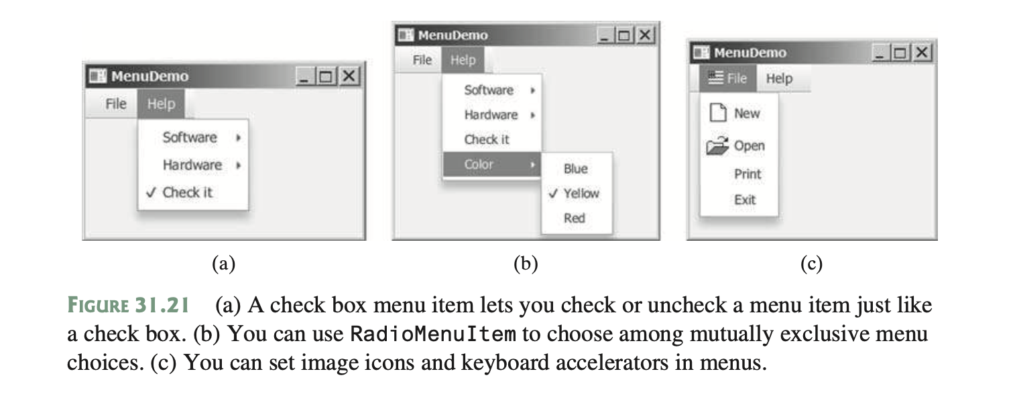
Creating Menus

Slide 18
Creating Menus
3.3. Creating radio menu items.
You can also add radio menu items to a menu, using the RadioMenuItem class. This is often useful when you have a group of mutually exclusive choices in the menu. For example, the following statements add a submenu named Color and a set of radio buttons for choosing a color (see Figure 31.21b):
RadioMenuItem rmiBlue, rmiYellow, rmiRed;
colorHelpSubMenu.getItems().add(rmiBlue =new RadioMenuItem("Blue"));
colorHelpSubMenu.getItems().add(rmiYellow =new RadioMenuItem("Yellow"));
colorHelpSubMenu.getItems().add(rmiRed =new RadioMenuItem("Red"));
ToggleGroup group = new ToggleGroup();
rmiBlue.setToggleGroup(group);
rmiYellow.setToggleGroup(group);
rmiRed.setToggleGroup(group);

Slide 19
Creating Menus
The menu items generate ActionEvent. To handle ActionEvent, implement the setOnAction method.
5. Image Icons and Keyboard Accelerators
The Menu, CheckMenuItem, and RadioMenuItem are the subclasses of MenuItem. The MenuItem has a graphic property for specifying a node to be displayed in the menu item. Usually, the graphic is an image view. The classes Menu, MenuItem, Check- MenuItem, and RadioMenuItem have another constructor that you can use to specify a graphic. For example, the following code adds an image to the menu, menu item, check menu item, and radio menu item (see Figure 31.21c).
Menu menuFile = new Menu("File",
new ImageView("image/usIcon.gif"));
MenuItem menuItemOpen = new MenuItem("New", new ImageView("image/new.gif"));
CheckMenuItem checkMenuItem = new CheckMenuItem("Check it", new ImageView("image/us.gif"));
RadioMenuItem rmiBlue = new RadioMenuItem("Blue", new ImageView("image/us.gif"));

Slide 20
Creating Menus
6. A key accelerator lets you select a menu item directly by pressing the CTRL and the accelerator key. For example, by using the following code, you can attach the accelerator key CTRL+N to the Open menu item:
menuItemOpen.setAccelerator( KeyCombination.keyCombination("Ctrl+O"));

Slide 21
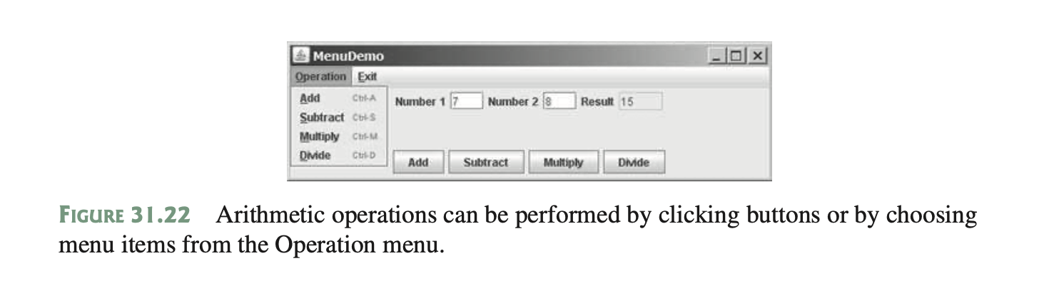
Example Menu Program
This section gives an example that creates a user interface to perform arithmetic. The inter- face contains labels and text fields for Number 1, Number 2, and Result. The Result text field displays the result of the arithmetic operation between Number 1 and Number 2. Figure 31.22 contains a sample run of the program.

Slide 22
Example Menu Program
Here are the major steps in the program (Listing 31.9):
1. Create a menu bar and add it into a VBox. Create the menus Operation and Exit, and add them to the menu bar. Add the menu items Add, Subtract, Multiply, and Divide under the Operation menu and add the menu item Close under the Exit menu.
2. Create an HBox to hold labels and text fields and place it into the VBox.
3. CreateanHBoxtoholdthefourbuttonslabeledAdd,Subtract,Multiply,andDivideand
place it into the VBox.
4. Implement the handlers to process the events from the menu items and the buttons.

Slide 23
Context Menus
You can create context menus in JavaFX.
A context menu, also known as a popup menu, is like a regular menu, but does not have a menu bar and can float anywhere on the screen. Creating a context menu is similar to creating a regular menu. First, you create an instance of ContextMenu, and then you can add MenuItem, CheckMenuItem, and RadioMenuItem to the context menu. For example, the following code creates a ContextMenu, then adds MenuItems into it:
ContextMenu contextMenu = new ContextMenu(); ContextMenu.getItems().add(new MenuItem("New")); ContextMenu.getItems().add(new MenuItem("Open"));

Slide 24
Context Menus
A regular menu is always added to a menu bar, but a context menu is associated with a parent node and is displayed using the show method in the ContextMenu class. You specify the parent node and the location of the context menu, using the coordinate system of the parent like this:
contextMenu.show(node, x, y);

Slide 25
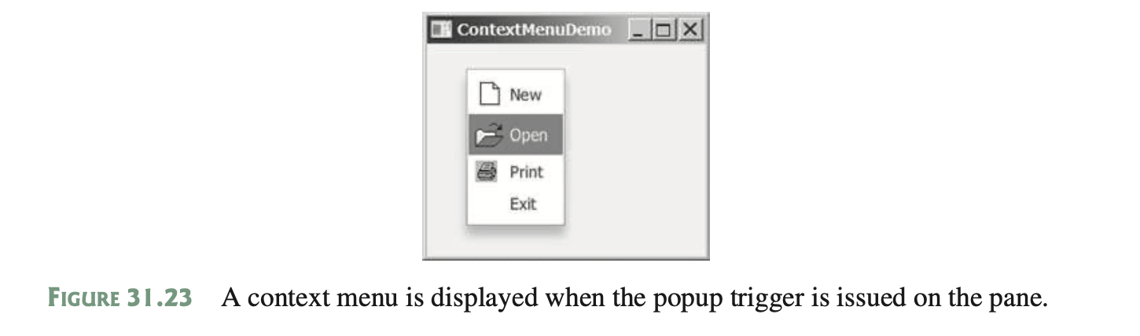
Context Menus
Customarily, you display a context menu by pointing to a GUI component and clicking a certain mouse button, the so-called popup trigger. Popup triggers are system dependent. In Windows, the context menu is displayed when the right mouse button is released. In Motif, the context menu is displayed when the third mouse button is pressed and held down.
Listing 31.10 gives an example that creates a pane. When the mouse points to the pane, clicking a mouse button displays a context menu, as shown in Figure 31.23.

Slide 26
Context Menus
Here are the major steps in the program (Listing 31.10):
1. Create a context menu using ContextMenu. Create menu items for New, Open, Print, and Exit using MenuItem.
2. Add the menu items into the context menu.
3. Create a pane and place it in the scene.
4. Implement the handler to process the events from the menu items.
5. Implement the mousePressed handler to display the context menu.

Slide 27
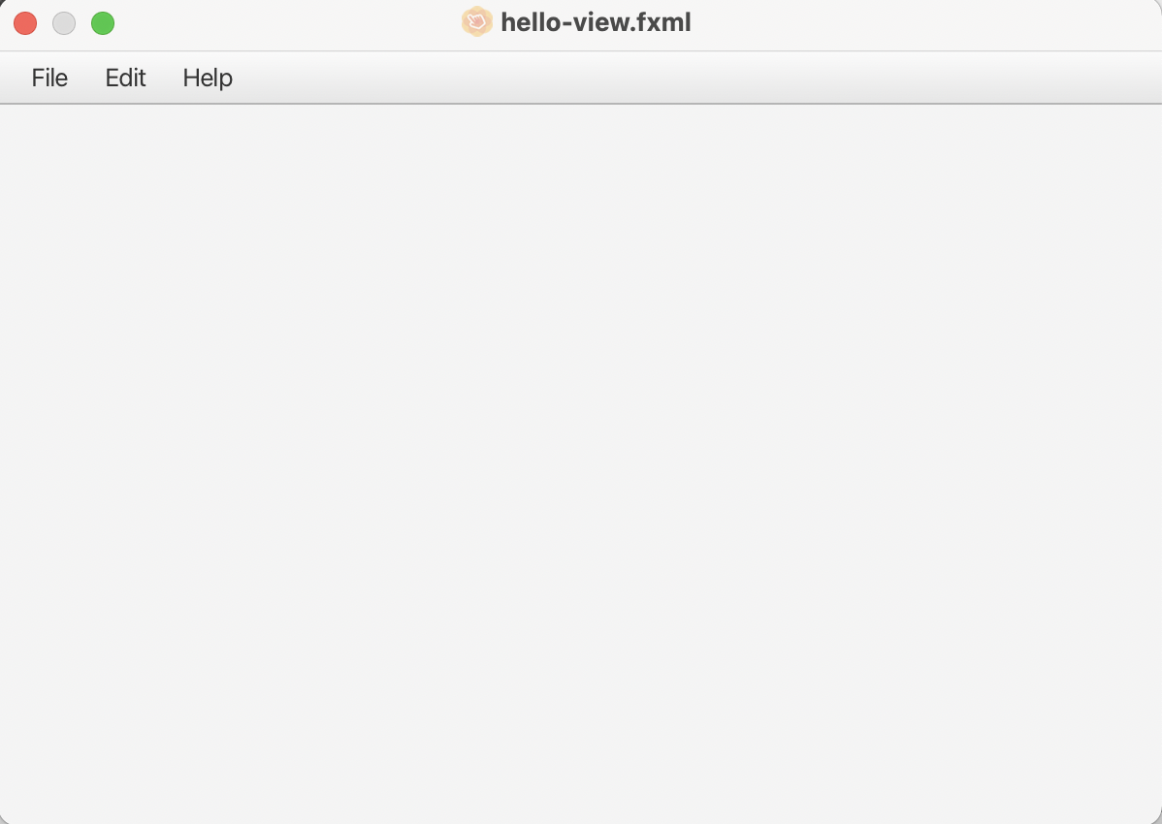
Visual Program Example - 1
Let's prepare a visual program by adding Menu Bar.

Slide 28
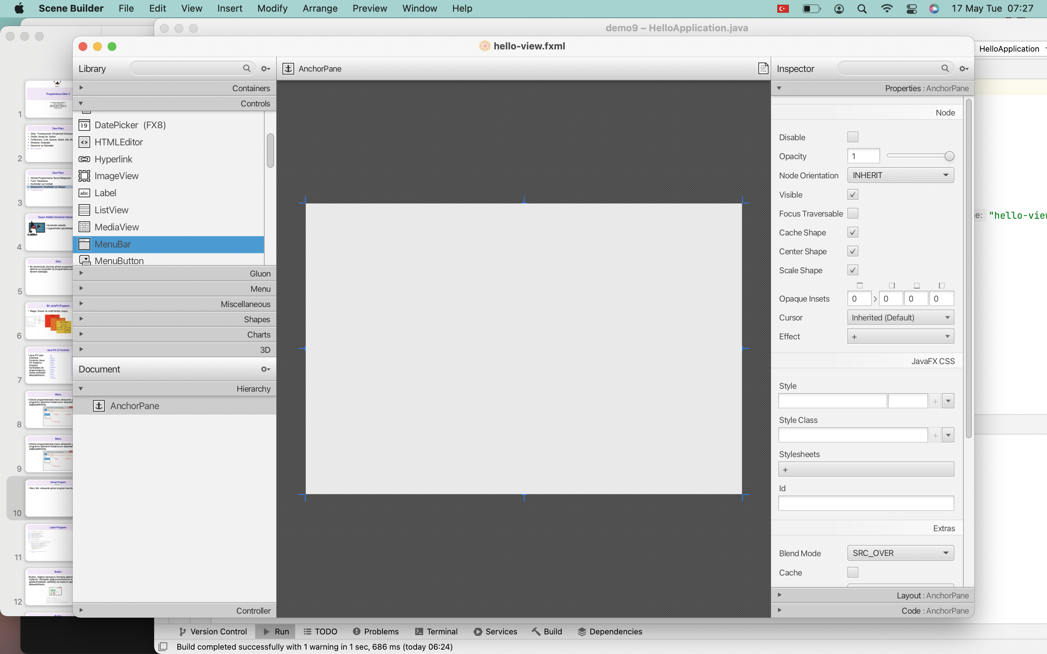
Menu Bar Program

Slide 29
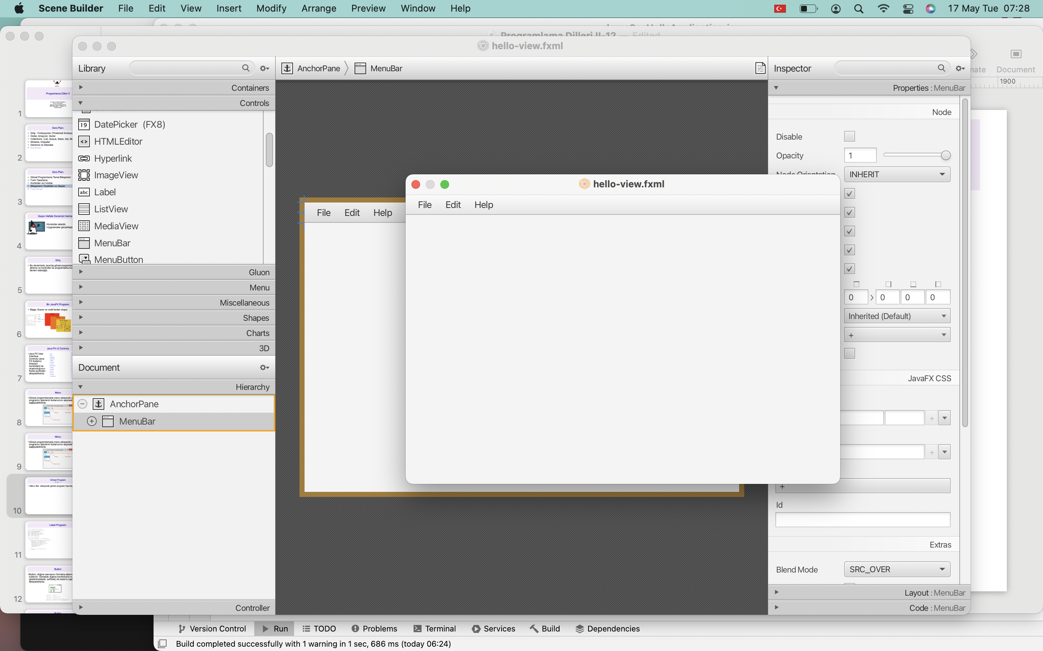
Menu Bar Program

Slide 30
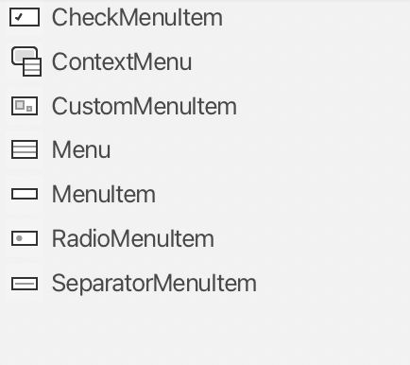
Menu
You can add the following to the menu you will create.

Slide 31
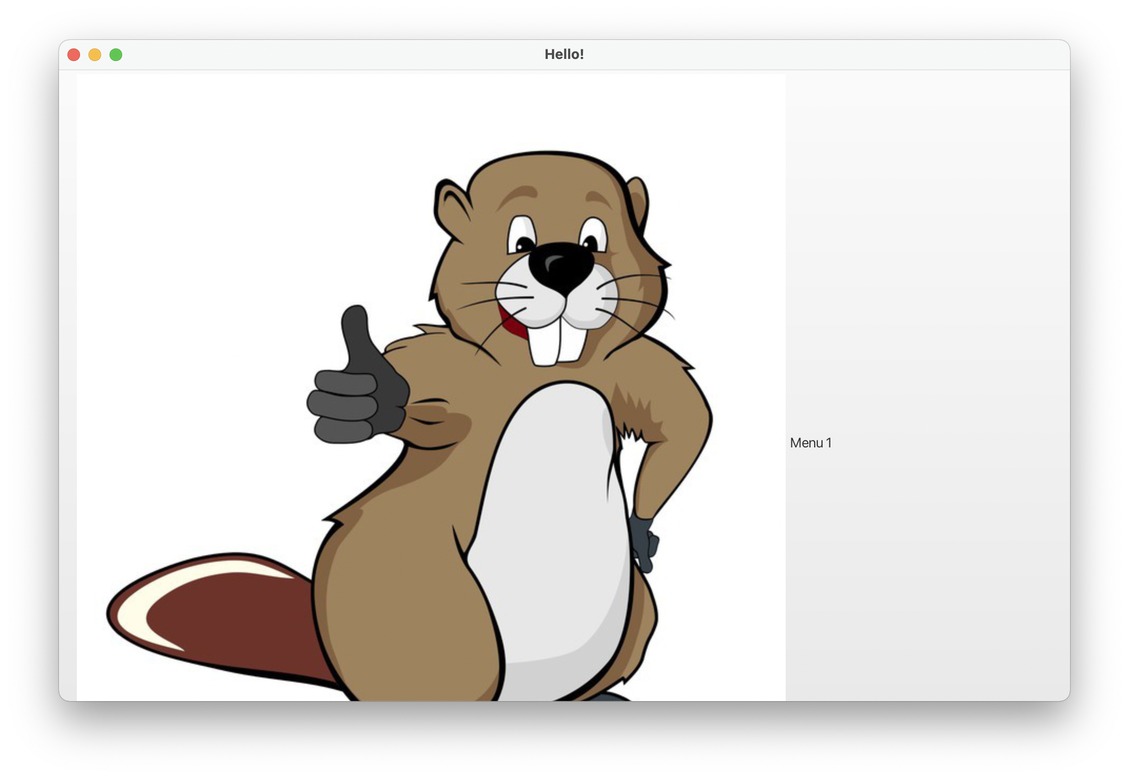
Visual Program Example - 2
Let's prepare a visual program by adding Menu Bar.

Slide 32
Menu Program
package com.example.demo9;
import javafx.application.Application;
import javafx.fxml.FXMLLoader;
import javafx.scene.Scene;
import javafx.scene.control.Menu;
import javafx.scene.control.MenuBar;
import javafx.scene.image.ImageView;
import javafx.scene.layout.VBox;
import javafx.stage.Stage;
import java.io.IOException;
public class HelloApplication extends Application {
@Override
public void start(Stage stage) throws IOException {
stage.setTitle("Hello!");
MenuBar menuBar = new MenuBar();
VBox vBox = new VBox(menuBar);
Scene scene = new Scene(vBox, 960, 600);
Menu menu1 = new Menu("Menu 1");
menu1.setGraphic(new ImageView("/tamam.jpg"));
menuBar.getMenus().add(menu1);
stage.setScene(scene);
stage.show();
}
public static void main(String[] args) {
launch();
}
}

Slide 33
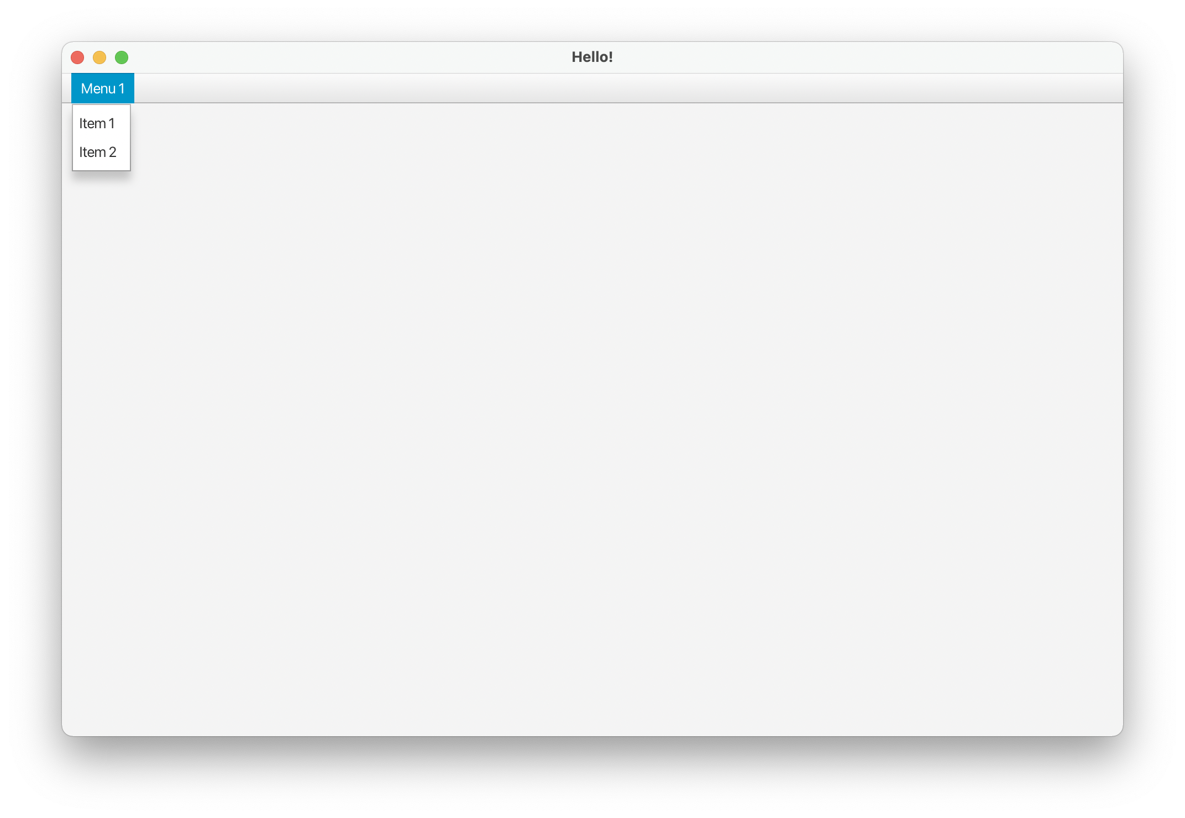
Visual Program Example - 3
Let's prepare a visual program by adding submenus.

Slide 34
Menu Program
package com.example.demo9;
import javafx.application.Application;
import javafx.fxml.FXMLLoader;
import javafx.scene.Scene;
import javafx.scene.control.Menu;
import javafx.scene.control.MenuBar;
import javafx.scene.control.MenuItem;
import javafx.scene.image.ImageView;
import javafx.scene.layout.VBox;
import javafx.stage.Stage;
import java.io.IOException;
public class HelloApplication extends Application {
@Override
public void start(Stage stage) throws IOException {
stage.setTitle("Hello!");
MenuBar menuBar = new MenuBar();
VBox vBox = new VBox(menuBar);
Scene scene = new Scene(vBox, 960, 600);
Menu menu = new Menu("Menu 1");
MenuItem menuItem1 = new MenuItem("Item 1");
MenuItem menuItem2 = new MenuItem("Item 2");
menu.getItems().add(menuItem1);
menu.getItems().add(menuItem2);
menuBar.getMenus().add(menu);
stage.setScene(scene);
stage.show();
}
public static void main(String[] args) {
launch();
}
}

Slide 35
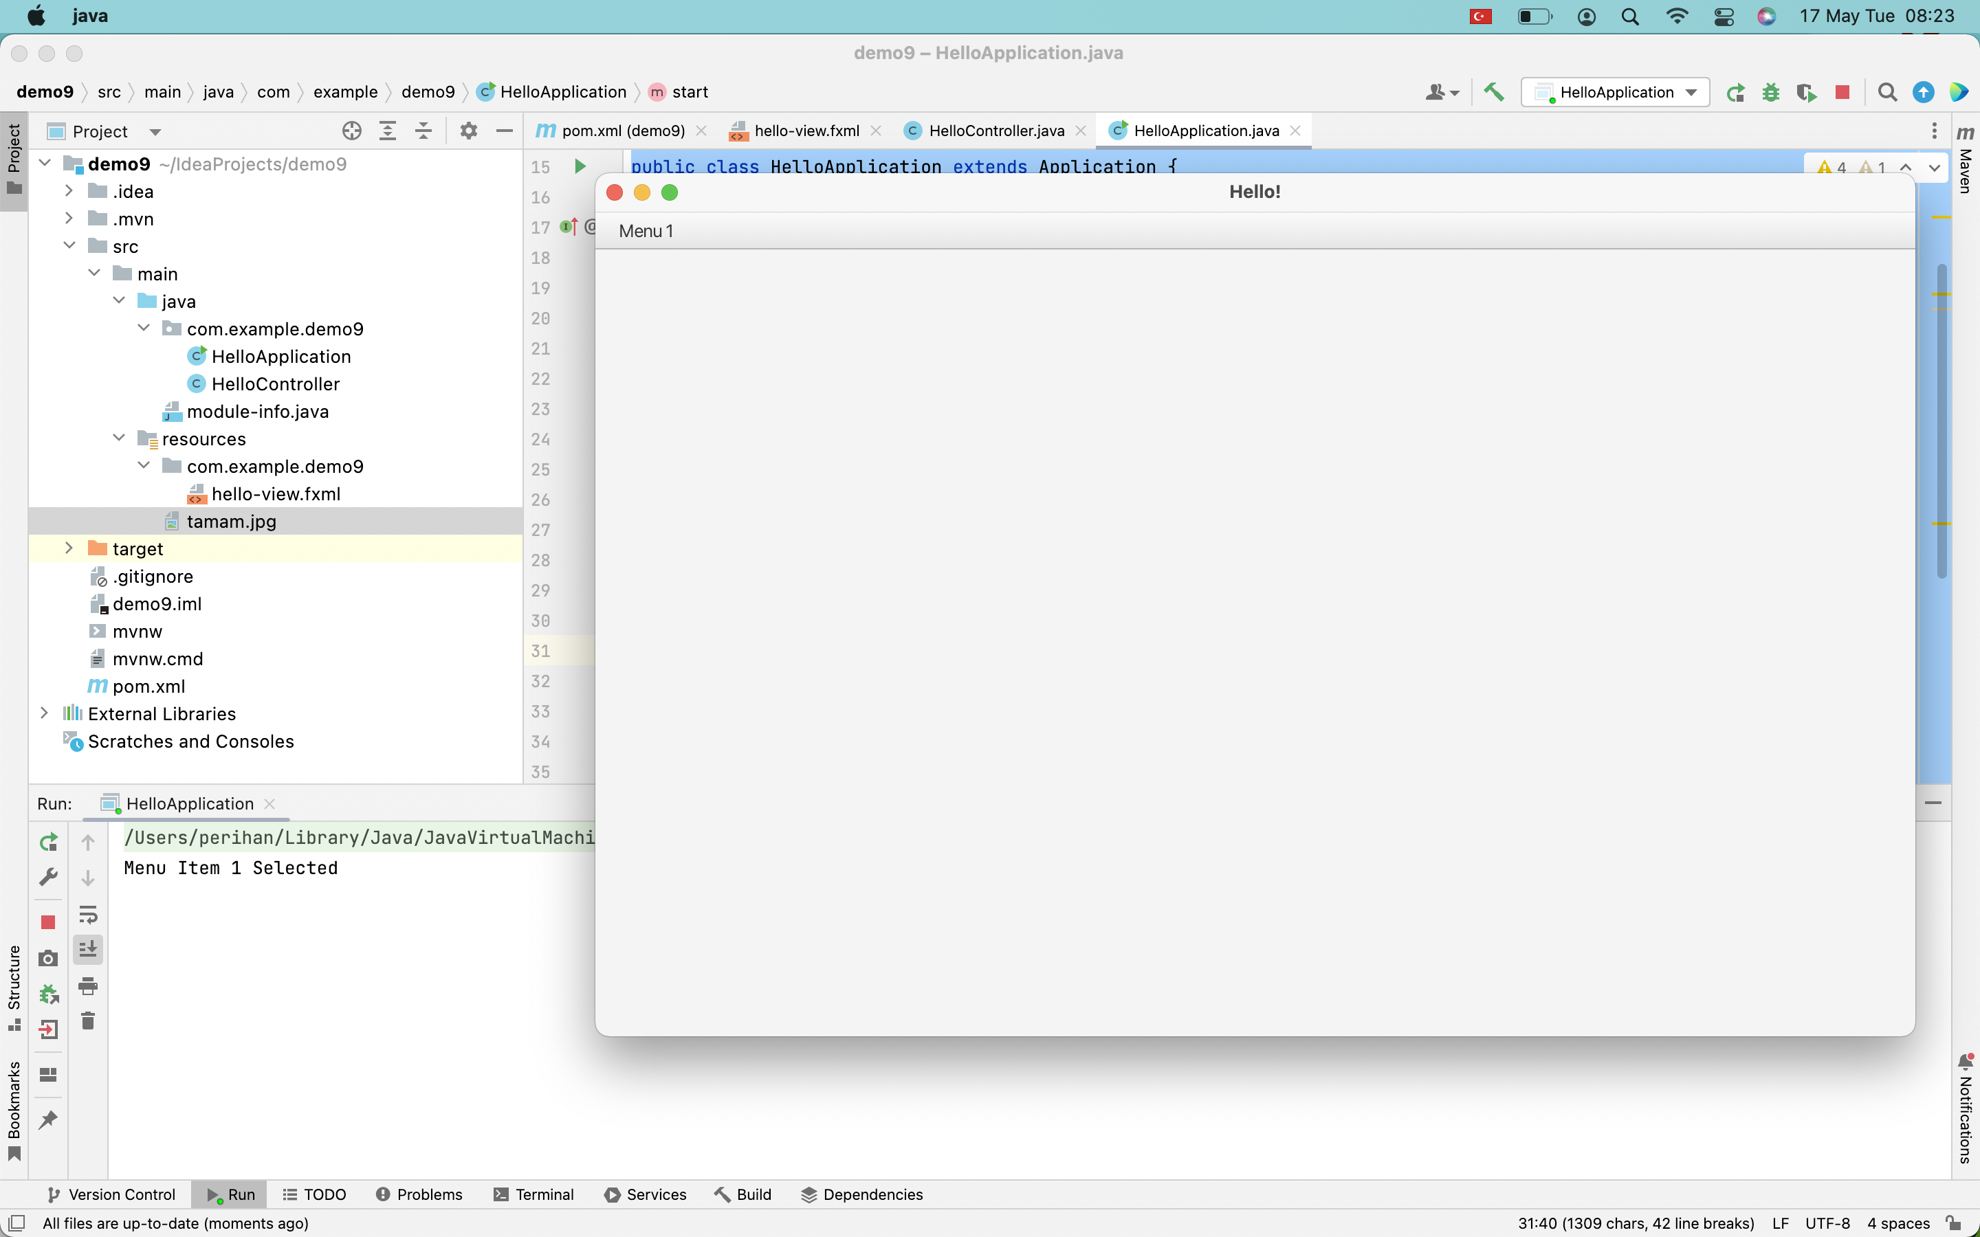
Visual Program Example - 4
When menu item is selected let us write a message.

Slide 36
Menu Item Program
package com.example.demo9;
import javafx.application.Application;
import javafx.fxml.FXMLLoader;
import javafx.scene.Scene;
import javafx.scene.control.Menu;
import javafx.scene.control.MenuBar;
import javafx.scene.control.MenuItem;
import javafx.scene.image.ImageView;
import javafx.scene.layout.VBox;
import javafx.stage.Stage;
import java.io.IOException;
public class HelloApplication extends Application {
@Override
public void start(Stage stage) throws IOException {
stage.setTitle("Hello!");
MenuBar menuBar = new MenuBar();
VBox vBox = new VBox(menuBar);
Scene scene = new Scene(vBox, 960, 600);
Menu menu = new Menu("Menu 1");
MenuItem menuItem1 = new MenuItem("Item 1");
MenuItem menuItem2 = new MenuItem("Item 2");
menu.getItems().add(menuItem1);
menu.getItems().add(menuItem2);
menuItem1.setOnAction(e -> {
System.out.println("Menu Item 1 Selected");});
menuBar.getMenus().add(menu);
stage.setScene(scene);
stage.show();
}
public static void main(String[] args) {
launch();
}
}

Slide 37
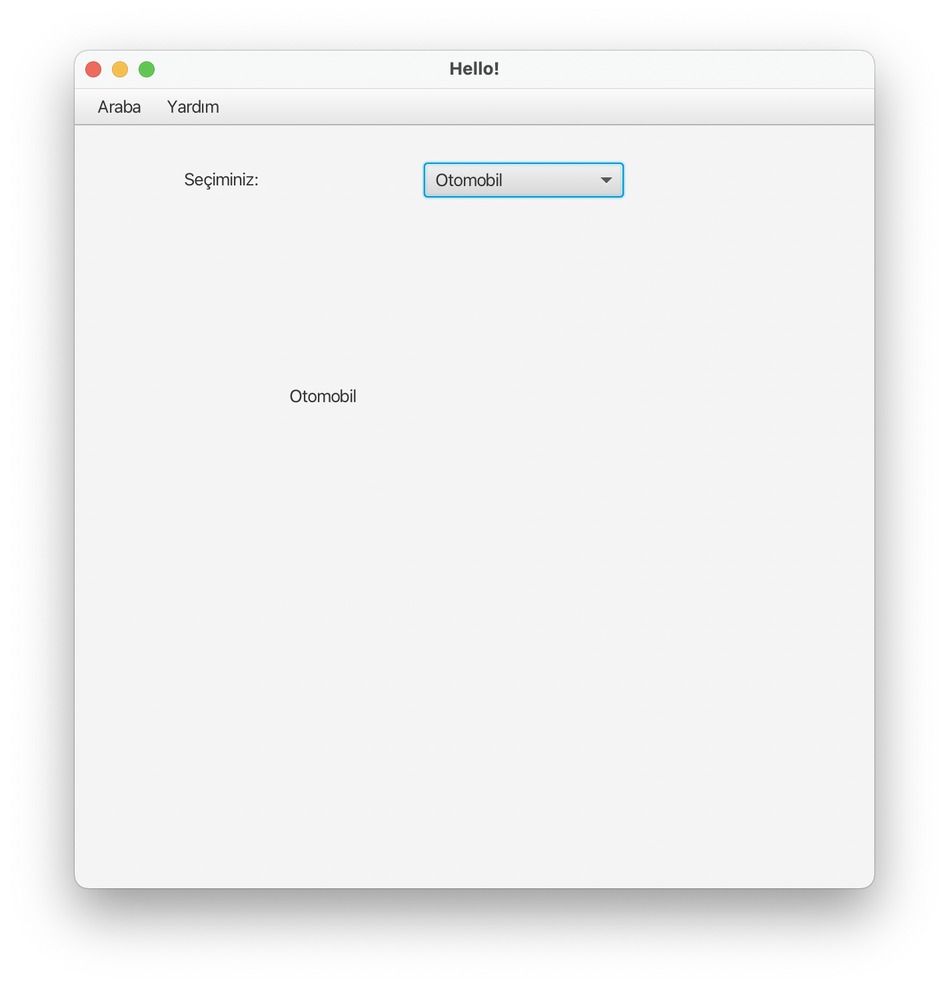
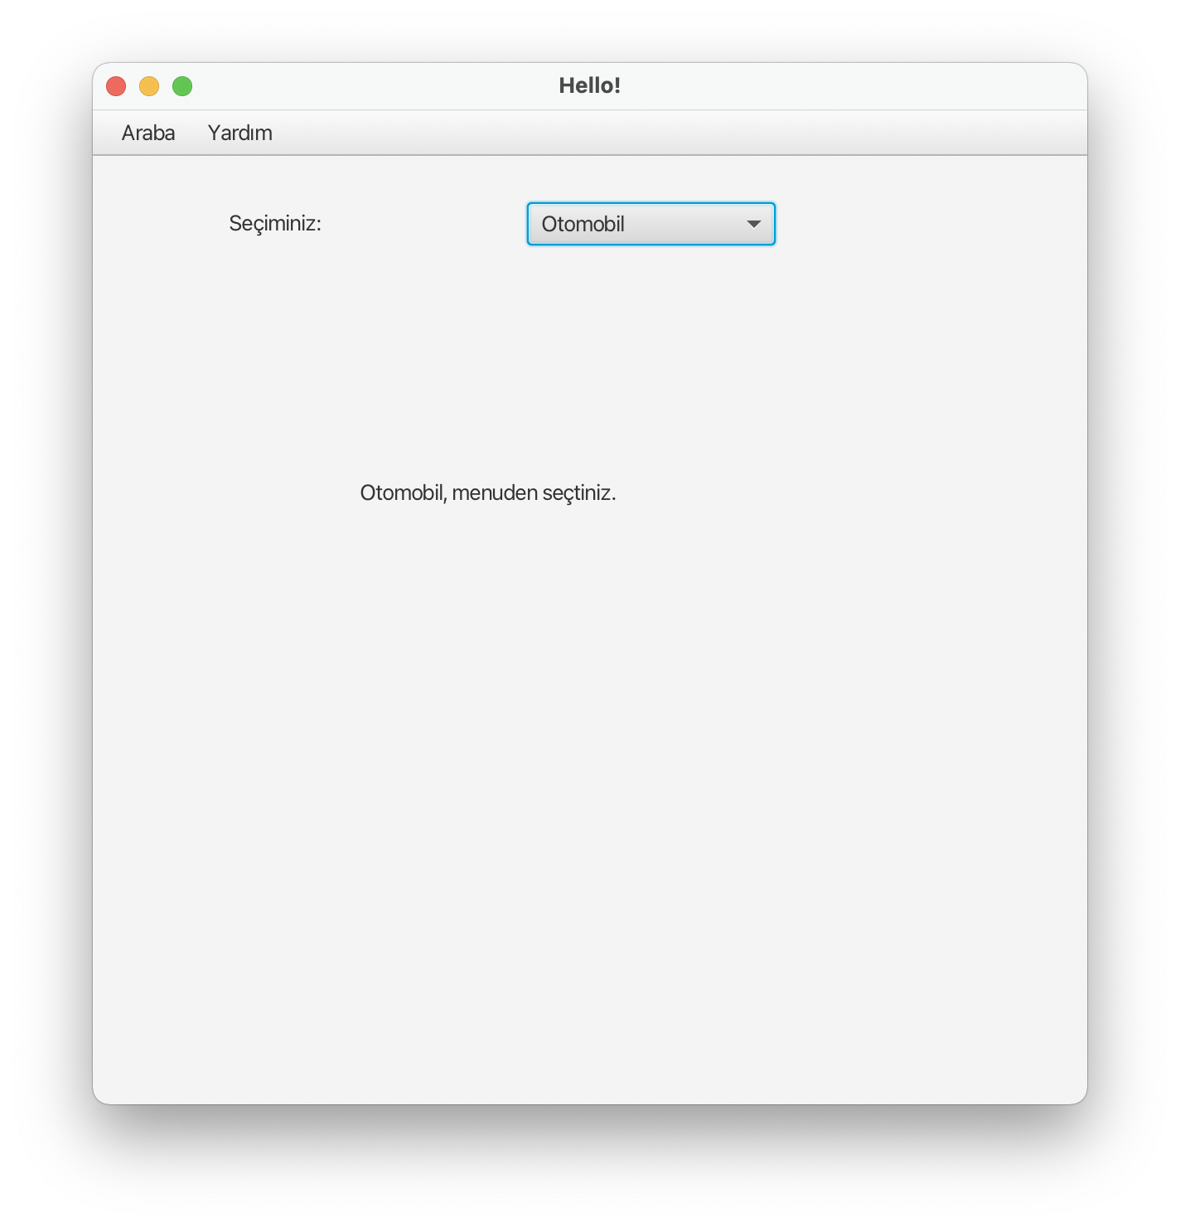
Visual Program Example - 5
Let's prepare a visual program using the combo box and menu.

Slide 38
Combo Box Program
package com.example.demo9;
import javafx.application.Application;
import javafx.fxml.FXMLLoader;
import javafx.scene.Scene;
import javafx.scene.control.Menu;
import javafx.scene.control.MenuBar;
import javafx.scene.control.MenuItem;
import javafx.scene.image.ImageView;
import javafx.scene.layout.VBox;
import javafx.stage.Stage;
import java.io.IOException;
public class HelloApplication extends Application {
@Override
public void start(Stage stage) throws IOException {
FXMLLoader fxmlLoader = new FXMLLoader(HelloApplication.class.getResource("hello-view.fxml"));
Scene scene = new Scene(fxmlLoader.load(), 600, 600);
stage.setTitle("Hello!");
stage.setScene(scene);
stage.show();
}
public static void main(String[] args) {
launch();
}
}

Slide 39
Combo Box Program
package com.example.demo9;
import javafx.collections.FXCollections;
import javafx.collections.ObservableList;
import javafx.event.ActionEvent;
import javafx.fxml.FXML;
import javafx.fxml.Initializable;
import javafx.scene.control.ComboBox;
import javafx.scene.control.Label;
import javafx.scene.control.MenuItem;
import java.net.URL;
import java.util.ResourceBundle;
public class HelloController implements Initializable {
@FXML
private ComboBox<String> comboBox;
@FXML
private Label ekran;
@FXML
private MenuItem yaz;
@FXML
void ekranaYaz(ActionEvent event) {
ekran.setText(comboBox.getValue().toString());
}
@FXML
void menudenSecEkranaYaz(ActionEvent event) {
ekran.setText(comboBox.getValue().toString()+", menuden seçtiniz.");
}
@Override
public void initialize(URL url, ResourceBundle resourceBundle) {
ObservableList <String> liste= FXCollections.observableArrayList("Otomobil", "Kamyon");
comboBox.setItems(liste);
}
}

Slide 40
Assign an initial value
To assign an initial value to the screen you prepare with Scene Builder, we must create the implements Initializable class:
public class HelloController implements Initializable {
@FXML
private ComboBox<String> comboBox;
@Override
public void initialize(URL url, ResourceBundle resourceBundle) {
ObservableList <String> liste= FXCollections.observableArrayList("Otomobil", "Kamyon");
comboBox.setItems(liste);
}
}

Slide 41
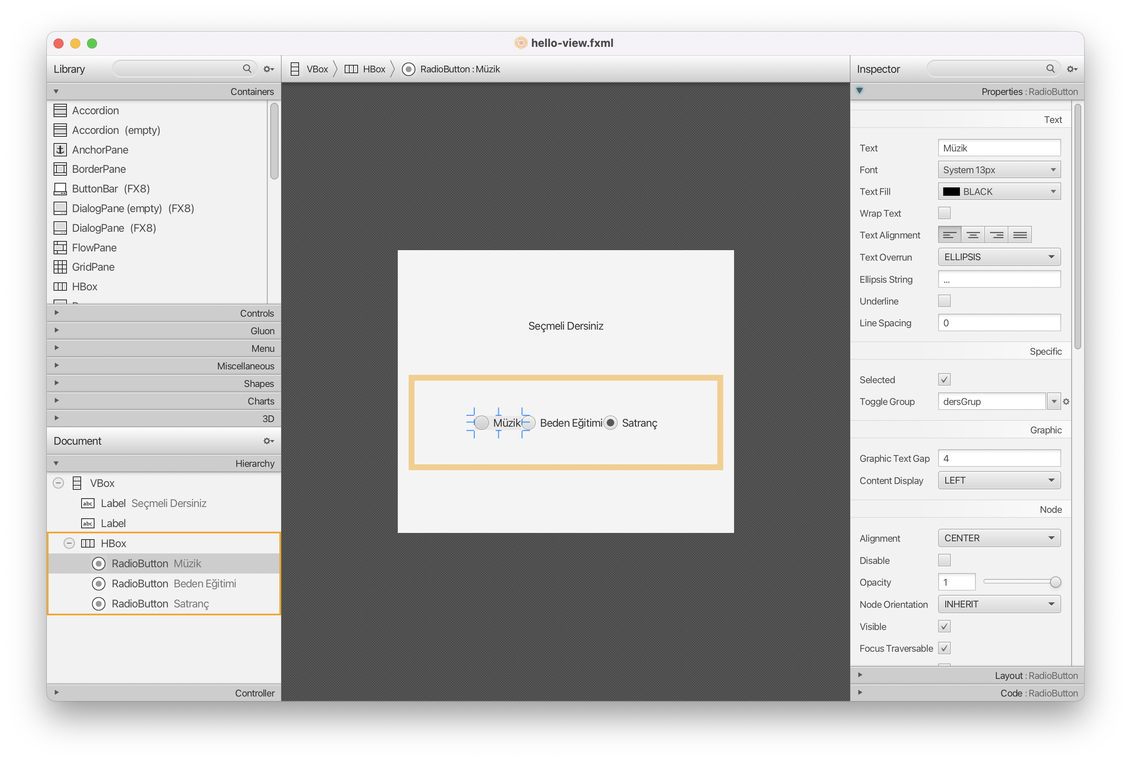
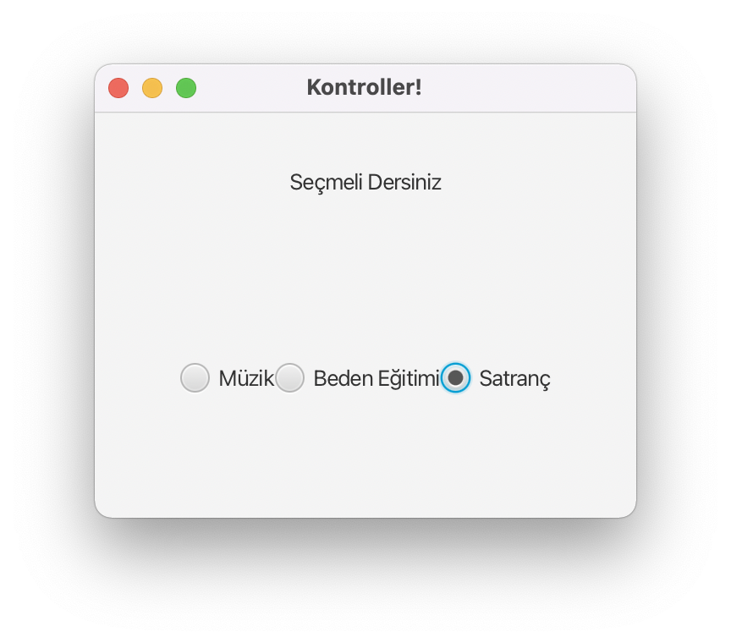
Visual Program, Radio button Example - 6
Write the program according to the screenshot below.

Slide 42
Visual Program Example - 6
package com.example.demo5;
import javafx.application.Application;
import javafx.fxml.FXMLLoader;
import javafx.scene.Scene;
import javafx.stage.Stage;
import java.io.IOException;
public class HelloApplication extends Application {
@Override
public void start(Stage stage) throws IOException {
FXMLLoader fxmlLoader = new FXMLLoader(HelloApplication.class.getResource("hello-view.fxml"));
Scene scene = new Scene(fxmlLoader.load(), 320, 240);
stage.setTitle("Kontroller!");
stage.setScene(scene);
stage.show();
}
public static void main(String[] args) {
launch();
}
}

Slide 43
Visual Program Example - 6
package com.example.demo5;
import javafx.fxml.FXML;
import javafx.scene.control.CheckBox;
import javafx.scene.control.ComboBox;
import javafx.scene.control.Label;
import javafx.scene.control.RadioButton;
public class HelloController {
@FXML
private RadioButton muzik, beden, satranc;
@FXML
private Label myLabel;
@FXML
protected void radioTikla() {
if (muzik.isSelected())
myLabel.setText("Müzik");
else if (beden.isSelected())
myLabel.setText("Beden");
else if (satranc.isSelected())
myLabel.setText("Satranç");
}
}

Slide 44
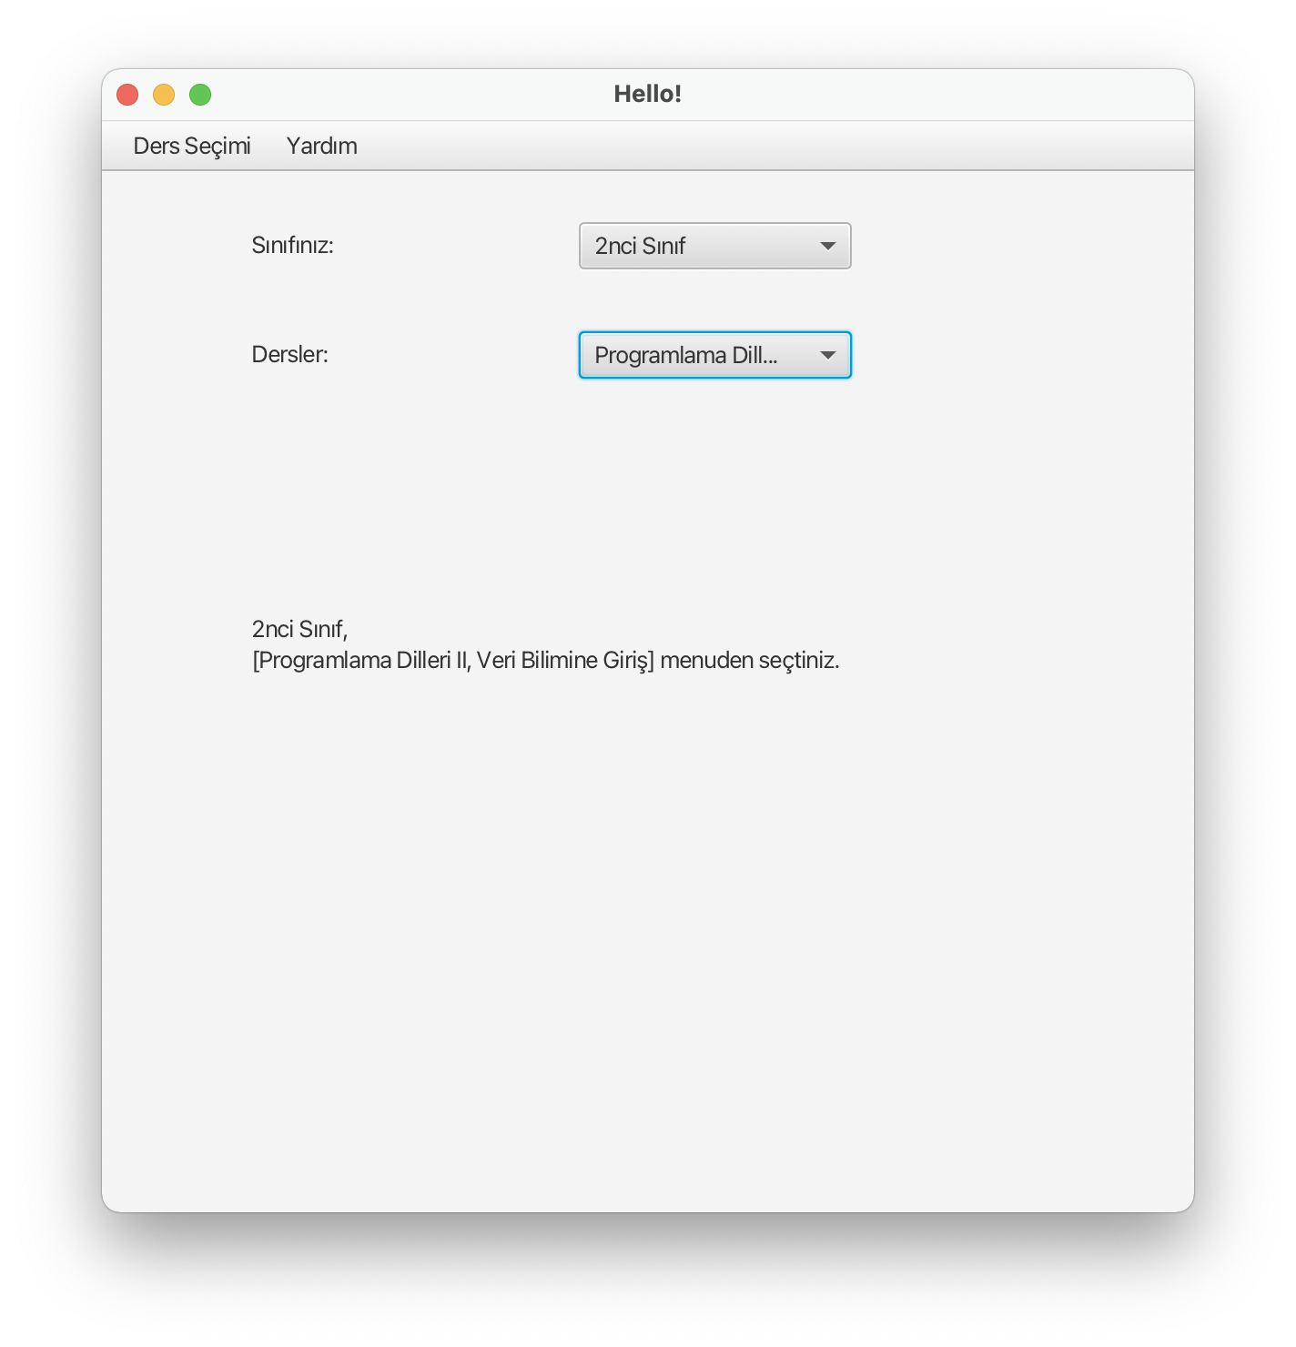
Visual Program, Combo box Example - 7
Write the program according to the screenshot below.

Slide 45
Visual Program Example - 7
package com.example.demo9;
import javafx.application.Application;
import javafx.fxml.FXMLLoader;
import javafx.scene.Scene;
import javafx.scene.control.Menu;
import javafx.scene.control.MenuBar;
import javafx.scene.control.MenuItem;
import javafx.scene.image.ImageView;
import javafx.scene.layout.VBox;
import javafx.stage.Stage;
import java.io.IOException;
public class HelloApplication extends Application {
@Override
public void start(Stage stage) throws IOException {
FXMLLoader fxmlLoader = new FXMLLoader(HelloApplication.class.getResource("hello-view.fxml"));
Scene scene = new Scene(fxmlLoader.load(), 600, 600);
stage.setTitle("Hello!");
stage.setScene(scene);
stage.show();
}
public static void main(String[] args) {
launch();
}
}

Slide 46
Visual Program Example - 7
package com.example.demo9;
import javafx.collections.FXCollections;
import javafx.collections.ObservableList;
import javafx.event.ActionEvent;
import javafx.fxml.FXML;
import javafx.fxml.Initializable;
import javafx.scene.control.ComboBox;
import javafx.scene.control.Label;
import javafx.scene.control.MenuItem;
import java.net.URL;
import java.util.ResourceBundle;
public class HelloController implements Initializable {
@FXML
private ComboBox<String> derslerComboBox;
@FXML
private Label ekran;
@FXML
private ComboBox<String> sinifComboBox;
@FXML
private MenuItem yaz;
@FXML
void sinifSec(ActionEvent event) {
ObservableList <String> derslerListe1 = FXCollections.observableArrayList("Mat", "Bilgisayar", "İngilizce");
ObservableList <String> derslerListe2 = FXCollections.observableArrayList("Programlama Dilleri II", "Veri Bilimine Giriş");
if (sinifComboBox.getValue().toString().equals("1inci Sınıf"))
derslerComboBox.setItems(derslerListe1);
else
derslerComboBox.setItems(derslerListe2);
}
@FXML
void ekranaYaz(ActionEvent event) {
ekran.setText(sinifComboBox.getValue().toString()+",\n"+derslerComboBox.getItems().toString());
}
@FXML
void menudenSecEkranaYaz(ActionEvent event) {
ekran.setText(sinifComboBox.getValue().toString()+",\n" +derslerComboBox.getItems().toString() + " menuden seçtiniz.");
}
@Override
public void initialize(URL url, ResourceBundle resourceBundle) {
ObservableList <String> sinifliste= FXCollections.observableArrayList("1inci Sınıf", "2nci Sınıf");
sinifComboBox.setItems(sinifliste);
}
}

Slide 47
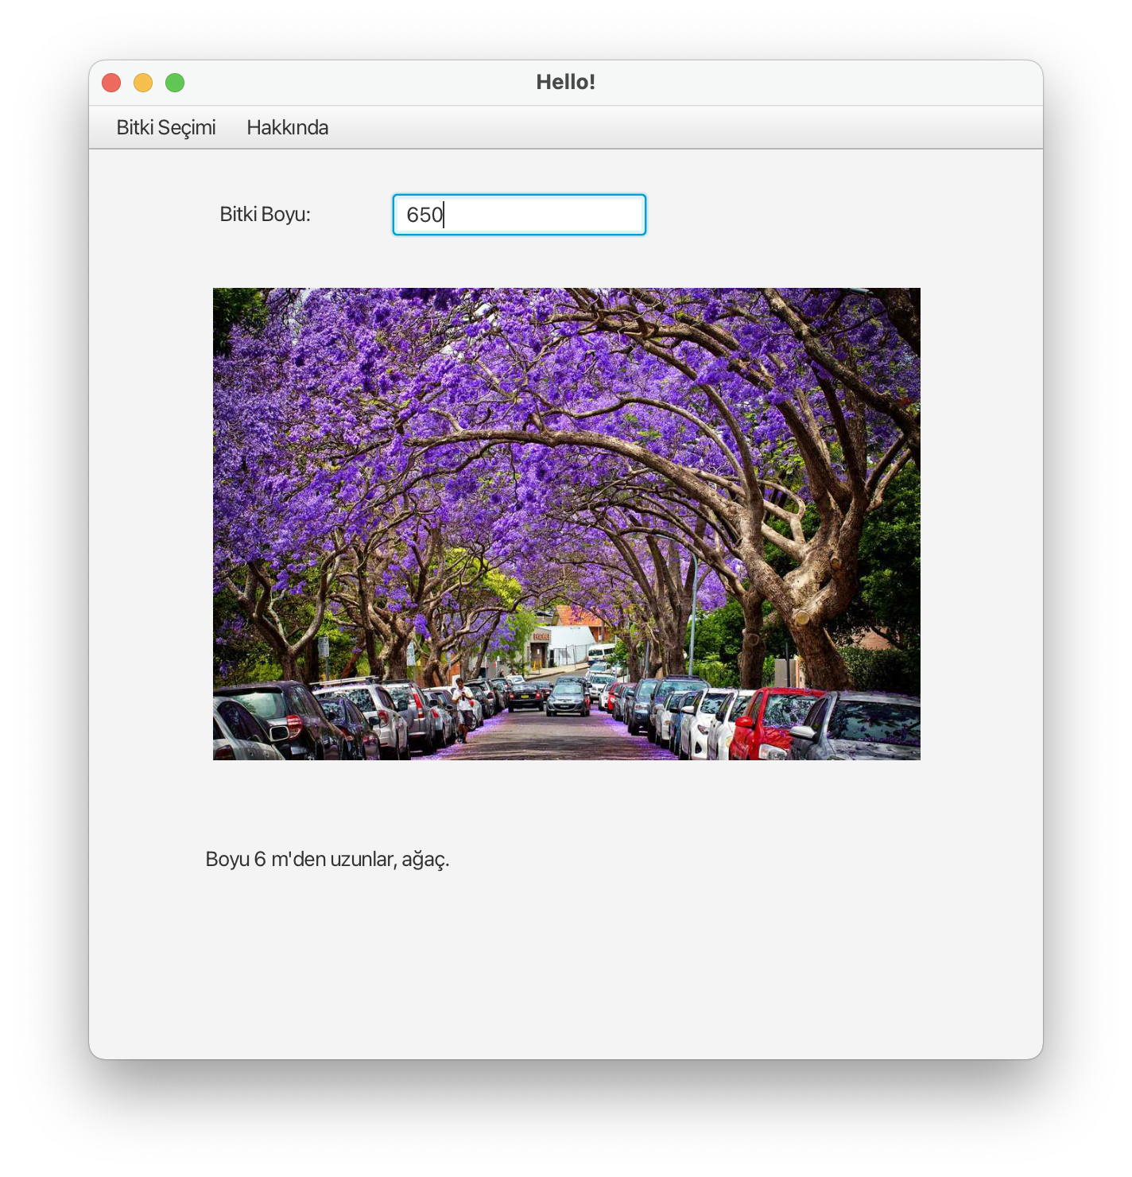
Visual Program Example - 8
Write the program according to the screenshot below.

Slide 48
Visual Program Example - 8
package com.example.demo9;
import javafx.application.Application;
import javafx.fxml.FXMLLoader;
import javafx.scene.Scene;
import javafx.scene.control.Menu;
import javafx.scene.control.MenuBar;
import javafx.scene.control.MenuItem;
import javafx.scene.image.ImageView;
import javafx.scene.layout.VBox;
import javafx.stage.Stage;
import java.io.IOException;
public class HelloApplication extends Application {
@Override
public void start(Stage stage) throws IOException {
FXMLLoader fxmlLoader = new FXMLLoader(HelloApplication.class.getResource("hello-view.fxml"));
Scene scene = new Scene(fxmlLoader.load(), 600, 600);
stage.setTitle("Hello!");
stage.setScene(scene);
stage.show();
}
public static void main(String[] args) {
launch();
}
}

Slide 49
Visual Program Example - 8
package com.example.demo9;
import javafx.collections.FXCollections;
import javafx.collections.ObservableList;
import javafx.event.ActionEvent;
import javafx.fxml.FXML;
import javafx.fxml.Initializable;
import javafx.scene.control.ComboBox;
import javafx.scene.control.Label;
import javafx.scene.control.MenuItem;
import javafx.scene.control.TextField;
import javafx.scene.image.Image;
import javafx.scene.image.ImageView;
import java.net.URL;
import java.util.ResourceBundle;
public class HelloController {
@FXML
private TextField boy;
@FXML
private Label ekran;
@FXML
private ImageView foto;
@FXML
private MenuItem yaz;
@FXML
void veriGir(ActionEvent event) {
if (Integer.parseInt(boy.getText())<41){
ekran.setText("Boyu 40 cm'e kadar olanlar, çiçek.");
foto.setImage(new Image("cicek.jpeg"));
}
else if (Integer.parseInt(boy.getText())<600) {
ekran.setText("Boyu 6 m'ye kadar olanlar, çalı.");
foto.setImage(new Image("cali.jpeg"));
}
else{
ekran.setText("Boyu 6 m'den uzunlar, ağaç.");
foto.setImage(new Image("agac.jpeg"));
}
}
@FXML
void menudenSecEkranaYaz(ActionEvent event) {
ekran.setText("2022 Bitki Seçimi Programı");
}
}

Slide 50
JavaFX CSS
JavaFX cascading style sheets can be used to specify styles for UI nodes.
JavaFX cascading style sheets are based on CSS with some extensions. CSS defines the style for webpages. It separates the contents of webpages from its style. JavaFX CSS can be used to define the style for the UI and separates the contents of the UI from the style. You can define the look and feel of the UI in a JavaFX CSS file and use the style sheet to set the color, font, margin, and border of the UI components. A JavaFX CSS file makes it easy to modify the style without modifying the Java source code.
A JavaFX style property is defined with a prefix –fx- to distinquish it from a property in CSS. All the available JavaFX properties are defined in http://docs.oracle.com/javafx/2/api/ javafx/scene/doc-files/cssref.html. Listing 31.1 gives an example of a style sheet.

Slide 51
JavaFX CSS
.plaincircle { -fx-fill: white; -fx-stroke: black; } .circleborder { -fx-stroke-width: 5; -fx-stroke-dash-array: 12 2 4 2; } .border { -fx-border-color: black; -fx-border-width: 5; } #redcircle { -fx-fill: red; -fx-stroke: red; } #greencircle { -fx-fill: green; -fx-stroke: green; }

Slide 52
JavaFX CSS
A style sheet uses the style class or style id to define styles. Multiple style classes can be applied to a single node, and a style id to a unique node. The syntax .styleclass defines a style class. Here, the style classes are named plaincircle, circleborder, and circleborder. The syntax #styleid defines a style id. Here, the style ids are named red- circle and greencircle.
Each node in JavaFX has a styleClass variable of the List<String> type, which can be obtained from invoking getStyleClass(). You can add multiple style classes to a node and only one id to a node. Each node in JavaFX has an id variable of the String type, which can be set using the setID(String id) method. You can set only one id to a node.

Slide 53
JavaFX CSS
The Scene and Parent classes have the stylesheets property, which can be obtained from invoking the getStylesheets() method. This property is of the ObservableList<String> type. You can add multiple style sheets into this property. You can load a style sheet into a Scene or a Parent. Note that Parent is the superclass for containers and UI control.

Slide 54
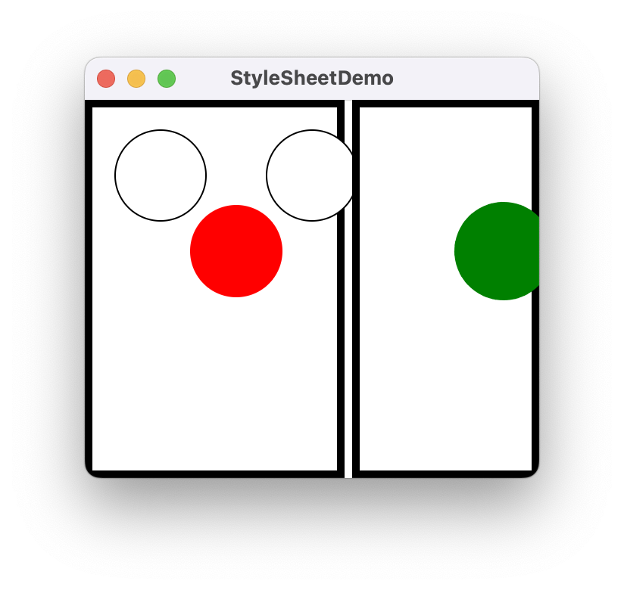
JavaFX CSS
package com.example.demo22; import javafx.application.Application; import javafx.scene.Scene; import javafx.scene.layout.HBox; import javafx.scene.layout.Pane; import javafx.scene.shape.Circle; import javafx.stage.Stage; public class HelloApplication extends Application { @Override // Override the start method in the Application class public void start(Stage primaryStage) { HBox hBox = new HBox(5); Scene scene = new Scene(hBox, 300, 250); scene.getStylesheets().add("myStyle.css");// Load the stylesheet Pane pane1 = new Pane(); Circle circle1 = new Circle(50, 50, 30); Circle circle2 = new Circle(150, 50, 30); Circle circle3 = new Circle(100, 100, 30); pane1.getChildren().addAll(circle1, circle2, circle3); pane1.getStyleClass().add("border"); circle1.getStyleClass().add("plaincircle"); // Add a style class circle2.getStyleClass().add("plaincircle"); // Add a style class circle3.setId("redcircle"); // Add a style id Pane pane2 = new Pane(); Circle circle4 = new Circle(100, 100, 30); circle4.getStyleClass().addAll("circleborder", "plainCircle"); circle4.setId("greencircle"); // Add a style class pane2.getChildren().add(circle4); pane2.getStyleClass().add("border"); hBox.getChildren().addAll(pane1, pane2); primaryStage.setTitle("StyleSheetDemo"); // Set the window title primaryStage.setScene(scene); // Place the scene in the window primaryStage.show(); // Display the window } }

Slide 55
JavaFX CSS
The program loads the style sheet from the file mystyle.css by adding it to the stylesheets property (line 13). The file should be placed in the same directory with the source code for it to run correctly. After the style sheet is loaded, the program sets the style class plaincircle for circle1 and circle2 (lines 22 and 23) and sets the style id redcircle for circle3 (line 24). The program sets style classes circleborder and plaincircle and an id greencircle for circle4 (lines 28 and 29). The style class border is set for both pane1 and pane2 (lines 20 and 31).
The style sheet is set in the scene (line 13). All the nodes inside the scene can use this style sheet. What would happen if line 13 is deleted and the following line is inserted after line 15?
pane1.getStylesheets().add("mystyle.css");

Slide 56
JavaFX CSS
In this case, only pane1 and the nodes inside pane1 can access the style sheet, but pane2 and circle4 cannot use this style sheet. Therefore, everything in pane1 is displayed the same as before the change, and pane2 and circle4 are displayed without applying the style class and id, as shown in Figure 31.1b.
Note the style class plaincircle and id greencircle both are applied to circle4 (lines 28 and 29). plaincircle sets fill to white and greencircle sets fill to green. The property settings in id take precedence over the ones in classes. Thus, circle4 is displayed in green in this program.

Slide 57

Homework - 1
Make examples on menu.

Slide 58
Next Lecture
We will continue.

Slide 59
Summary
We learned menu design.
Next week we’ll continue. Come to class prepared.

